Slide 1
CSC 101 – Introduction to Computing
Lecture 1-2

Slide 2
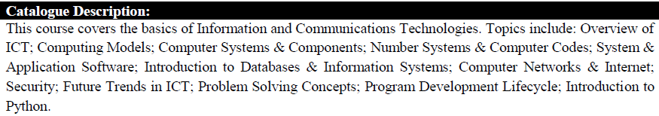
Course Information

Slide 3
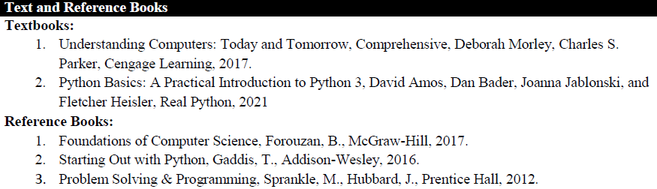
Books

Slide 4
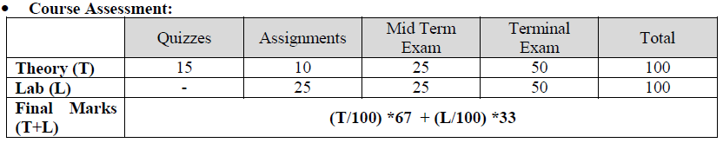
Assessment Plan for the Course:

Slide 5
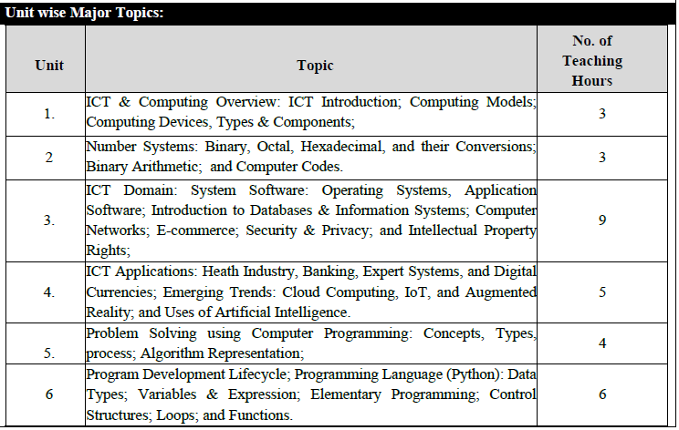
Major Topics Covered in the Course
Notes:
15 weeks

Slide 6
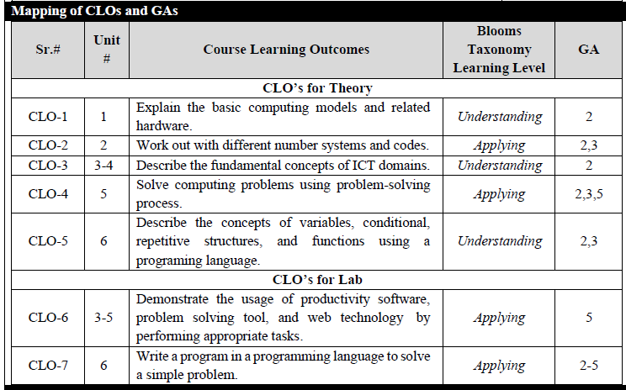
Course Learning Outcomes

Slide 7
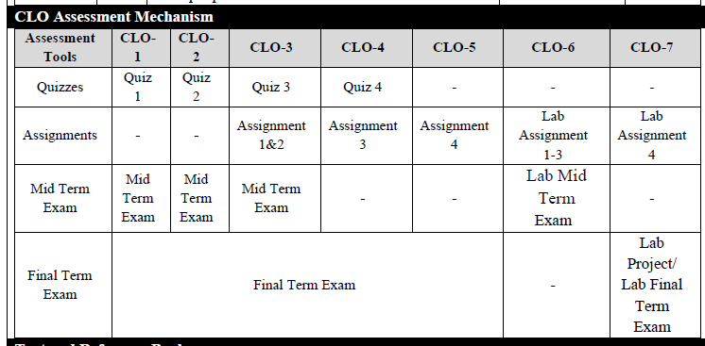
CLO Assessment

Slide 8
Plagiarism Policy
Any assignment found 20% or more copied from the internet will be marked 0 (ZERO).
Any assignment copied from the class mate will also be marked 0 (ZERO).
Both for the source and the copied one.
No consideration will be made regarding plagiarized assignments.

Slide 9
Attendance Policy
Any student late in class by 15 min shall be marked absent.

Slide 10
Contact
Office
226, Second Floor, CS Department(AB II)
Email
Sundus.waleed@comsats.edu.pk

Slide 11
Lecture 01

Slide 12
Outline
Definition of IT
Computer Technology
Communication Technology
Role of IT in Society
Models:
Turing Model
Von Neumann Model
Input Devices
Output Devices
Central Processing Unit
Control Unit
Arithmetic & Logic Unit
System Clock & Machine Cycle

Slide 13

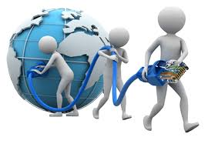
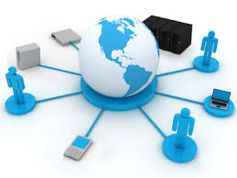

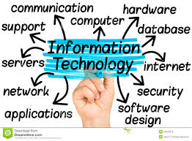
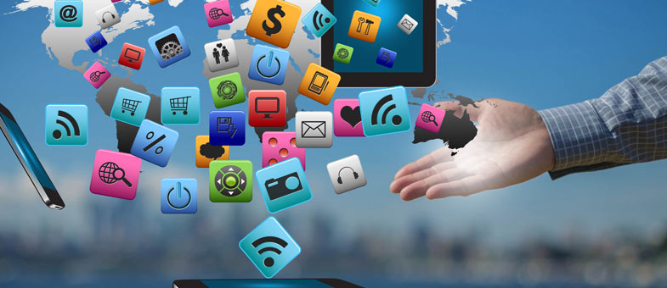
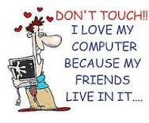
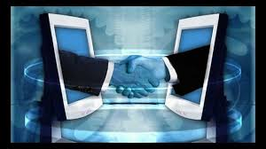

Slide 14
What is Information Technology
Fusion of computer and communication technology
Computer Technology
programmable, multiuse machine that accepts data and processes it into usable information
summaries, totals, or reports
used to speed up problem solving and increase productivity.

Slide 15
What is Information Technology
Communication Technology
consists of electromagnetic/optical devices and systems for communicating over long distances
InfoTech or IT is any technology that helps to produce, manipulate, store, communicate, and/or disseminate information
merges computing with high-speed communications links carrying data, sound, and video

Slide 16
Exercise
How have you been using Information Technology in your life?

Slide 17
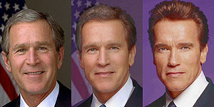
Some examples of IT
Image Morphing
changing (or morphing) one image into another through a seamless transition
Image Courtesy: http://en.wikipedia.org/wiki/Morphing
Notes:
3 Frames form a morph from George W. Bush to Arnold Schwarzenegger showing also the mid-point between the two extremes

Slide 18
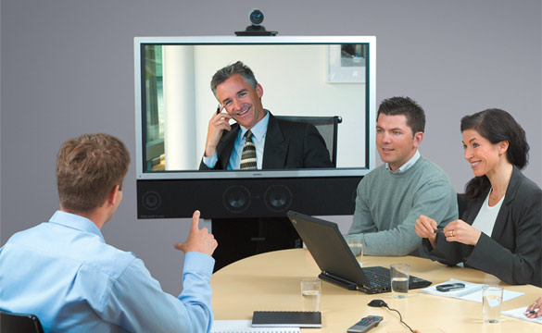
Some examples of IT
Video Conferencing

Slide 19
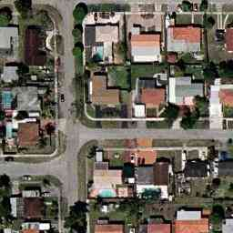
Some examples of IT
GPS Tracking
Track your vehicles, wherever they go, using GPS.

Slide 20
What is a Computer and What Does it Do?
Computer
A programmable, electronic device that accepts data, performs operations on that data, and stores the data
Follows instructions, called programs, which determine the tasks the computer will perform
Basic Operations
Input: Entering data into the computer
Processing: Performing operations on the data
Output: Presenting the results
Storage: Saving data, programs, or output for future use
Communications: Sending or receiving data

Slide 21
Communication Defined
Communication: To transfer data/information from one point to another
Using Wires
Electrical Signals
Optical Signals (Light)
Wirelessly
ElectroMagnetic Waves
Acoustic Waves (Sound) ….?
Using Analog Signals
Using Digital Signals

Slide 22
Related IT terms
What is a Network?
communications system connecting two or more computers with/without wires
What does being online mean?
using a computer or other information device, connected through a voice or data network, to access information and services from another computer or information device

Slide 23
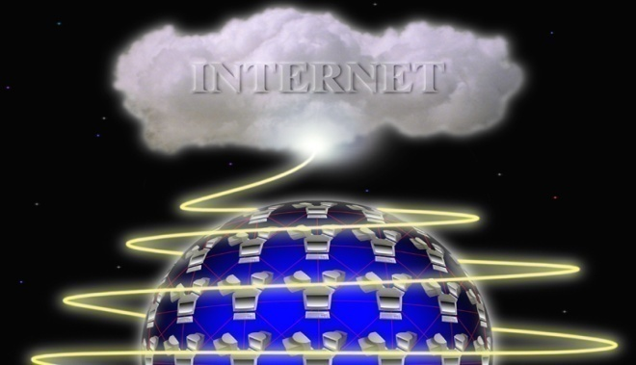
Related IT terms
Cyberspace
encompasses the whole wired and wireless world of communications
The Internet
the “network of all networks”
Multimedia
technology that presents information in more than one medium, such as text, still images, moving images, and sound
World Wide Web
“graphical side of the Internet”
global network of linked documents on the Internet

Slide 24
Related IT terms
The E-word ; E Stands for Electronic
E-mail
E-learning
E-business
E-commerce
E-government

Slide 25
Exercise
Generate a list of ways the computer/IT has impacted the world.
Include both positive changes and negative changes.
think creatively.

Slide 26
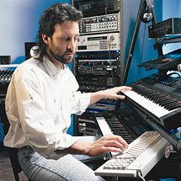
Computers In Society
Computers at home
Computers in government
Necessary to track data for population
Police officers
Tax calculation and collection
Computers in education
Computers in industry
Computers in small business
Notes:
Insider information
The 2000 Census determined that 51% of American households had computers. Over 42% of these households also had Internet access. This can be contrasted to 36% and 18% in 1997. See www.census.gov/prod/2001pubs/p23-207.pdf for more information.

Slide 27
Computers in the Home
Computers used for a variety of tasks:
Looking up information and news
Shopping and paying bills
Watching TV and videos
Downloading music and movies
Organizing digital photographs
Playing games
Smart appliances
Smart homes

Slide 28
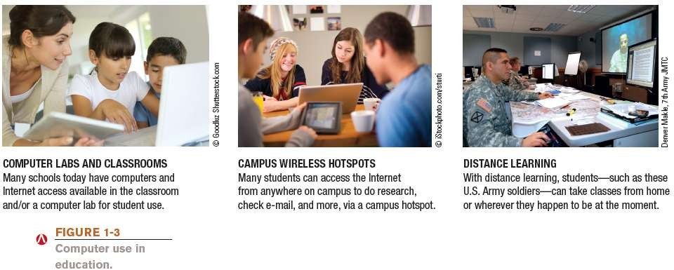
Computers in Education

Slide 29
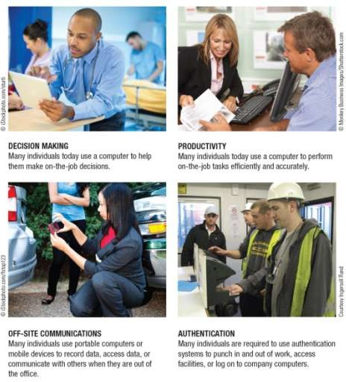

Computers on the Job

Slide 30
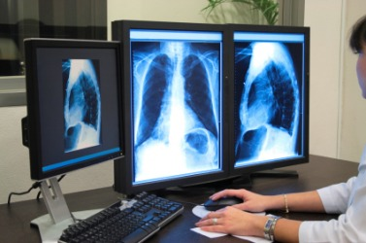
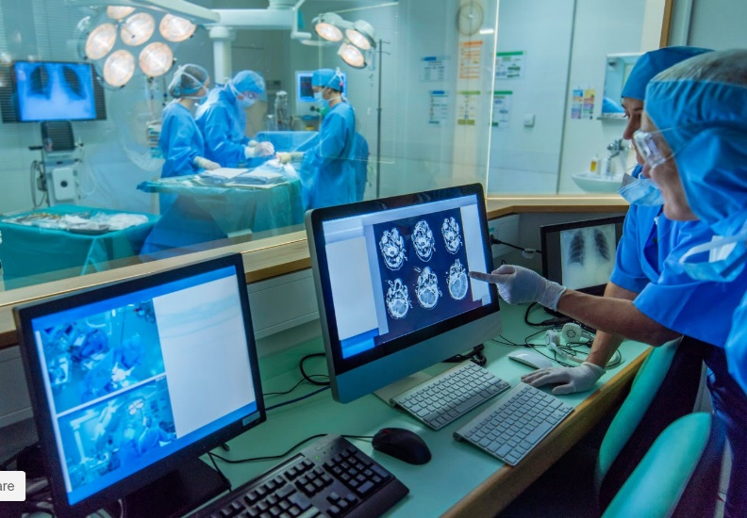
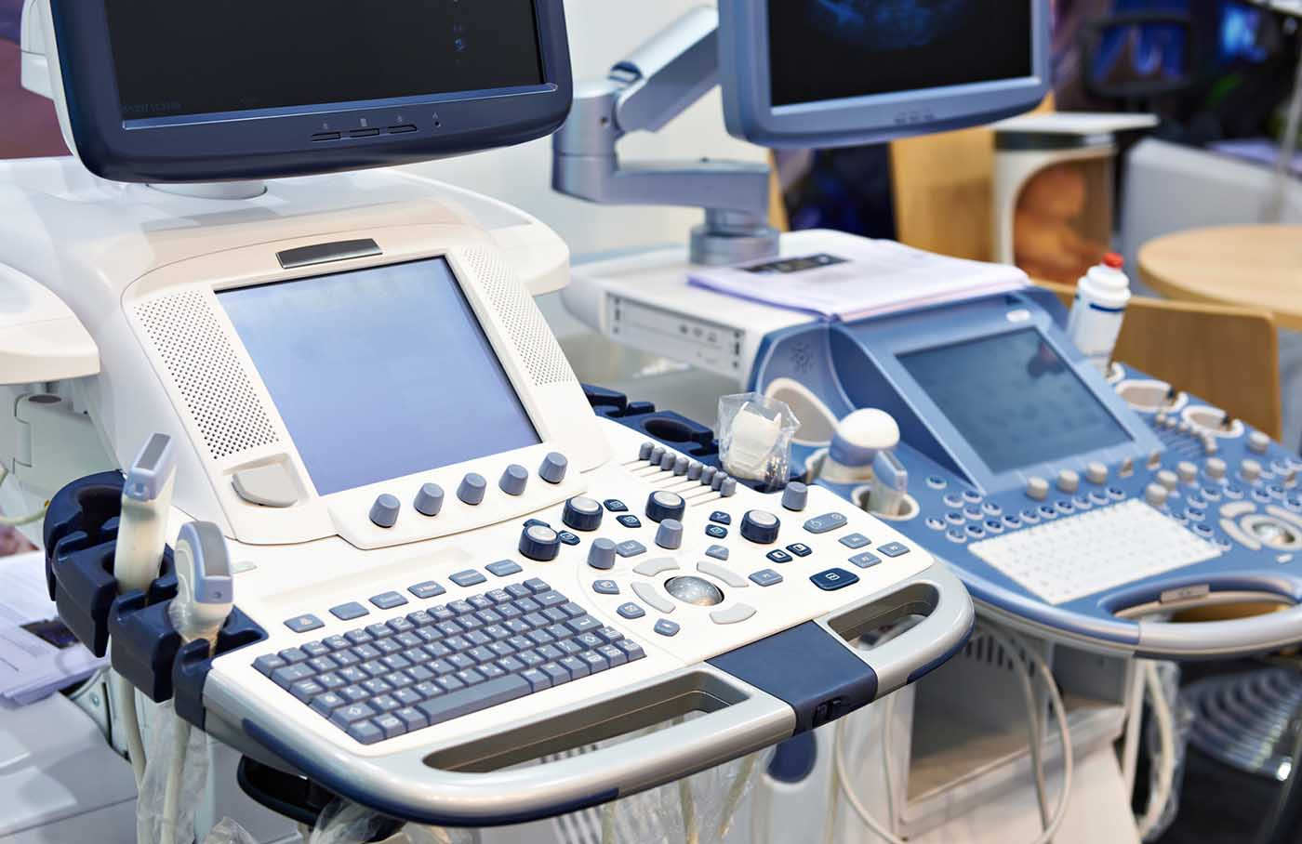
Computers In Health Care
Revolutionized health care
New treatments possible
Scheduling of patients has improved
Delivery of medicine is safer
Notes:
Page 19 of the text introduces the first Norton Notebook, the Merging of Media and Meaning. The author draws an analogy between electricity and computers in our lives. Discuss how difficult live would be without either of these devices. Remember that computers exist in nearly all of our modern devices, including cars, phones, kitchen appliances and entertainment devices.

Slide 31
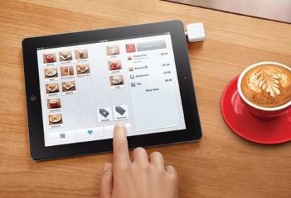
Computers on the Go
Computers are encountered in nearly every aspect of daily life
Consumer kiosks
ATM transactions
POS systems at retail stores
Self-checkout systems
Consumer authentication systems
GPS systems
Used in conjunction with e-menus

Slide 32
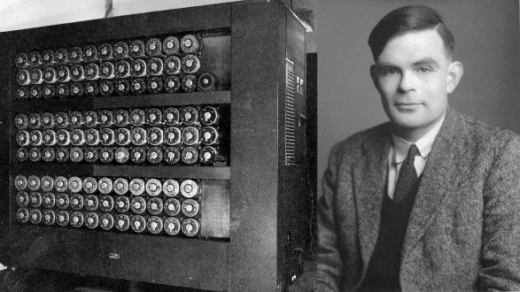
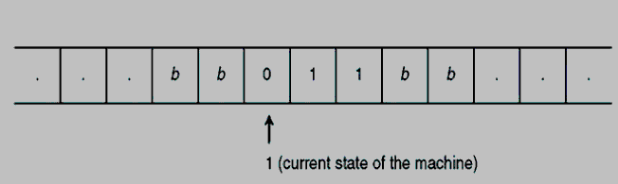
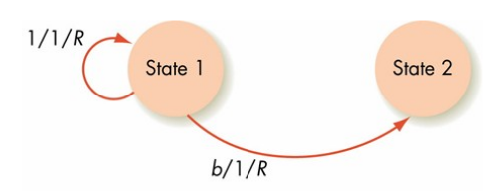
Allen Turing (1912-1954)
The Turing Machine Aka The Universal Machine (1936) includes
A conceptual Tape that extends infinitely to both directions
Holds the input to the turing machine
Serves as memory
The tape is divided in cells
A unit that reads one cell of the tape and writes a symbol in that cell
Notes:
The story of modern electronic digital computing should start with Alan Turing who published a paper in 1936 On Computable Numbers, with an application to the Entscheidungs problem. The paper proved that a machine capable of processing a stream of 1s and 0s according to programmed instructions would be capable of solving any problem that would count as a 'definite method.' As it happens, the set of problems included in this definition is the universe of mechanically solvable problems. Hence, the Turing Machine is also known as the Universal Machine, the theoretical precursor to the electronic digital computer which Atanasoff was soon to invent.

Slide 33
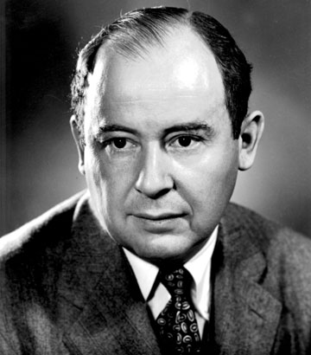
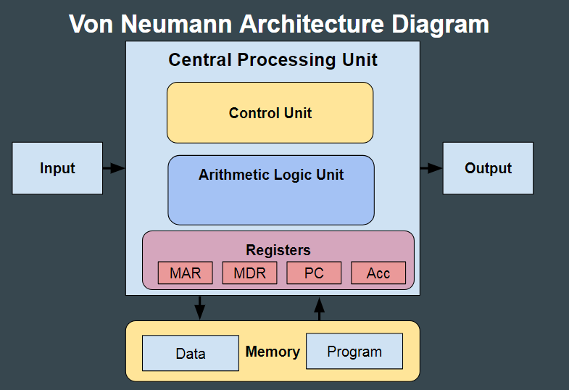
John von Neumann (1945)
A processing unit with both an arithmetic logic unit and processor registers
A control unit that includes an instruction register and a program counter
Memory that stores data and instructions
External mass storage
Input and output mechanisms

Slide 34
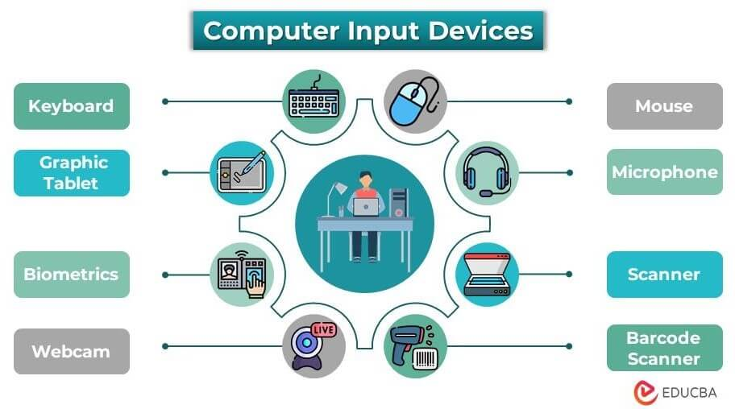
Input Devices
Hardware used to enter data and instructions

Slide 35
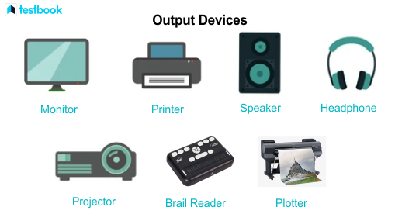
Output Devices

Slide 36
The System Unit and CPU

Slide 37
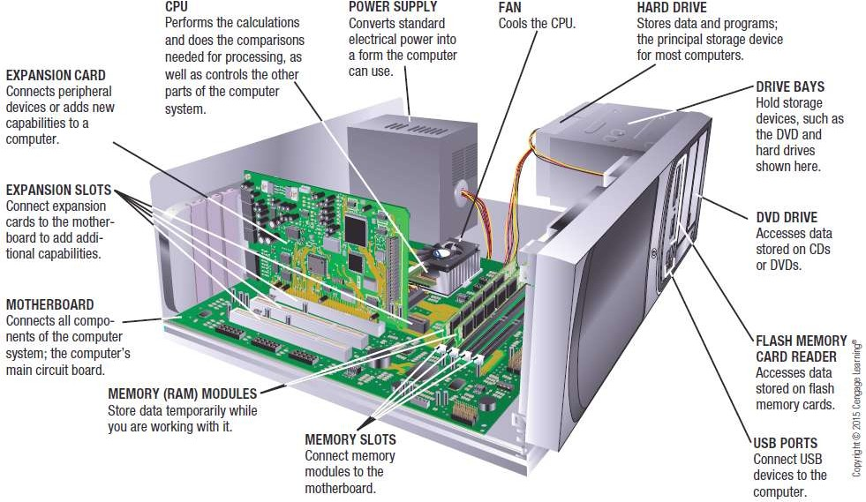
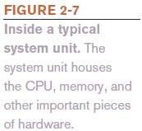
Inside the System Unit

Slide 38
Inside the System Unit
Central Processing Unit
Dual-core CPU
Contains the processing components (cores) of two separate processors on a single CPU
Quad-core CPU
Contains four cores
Multi-core processors allow computers to work on more than one task at a time
Typically different CPUs for desktop computers, portable computers, servers, mobile devices, consumer devices, etc.

Slide 39
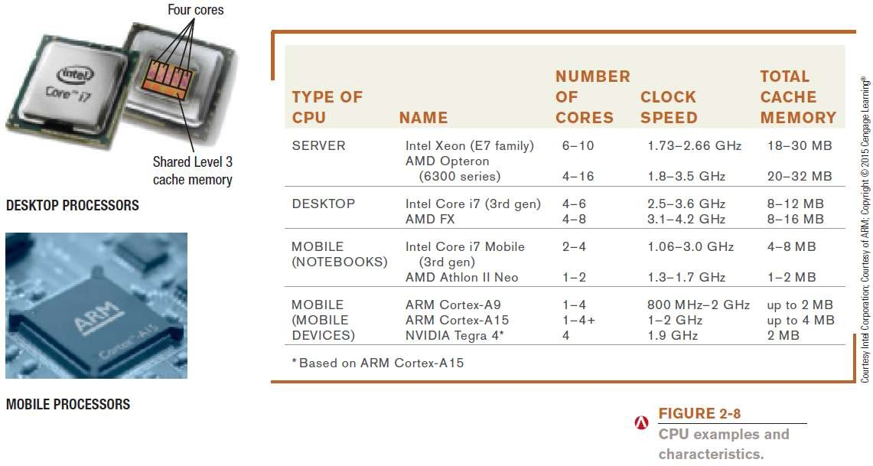
Inside the System Unit

Slide 40
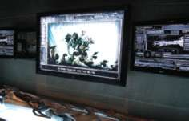
Inside the System Unit
The GPU (graphics processing unit)
Takes care of the processing needed to display images (including still images, animations) on the screen
Example: The Ride 3D at Universal Studios
Uses a 2,000 foot-long track, 14 huge screens, and 34 projectors
Motion is synchronized with the action
Images are 3D, 4K
Used GPUs to see 3D animations in real time as they were being developed

Slide 41
Inside the System Unit (CPU)
Processing Speed
CPU clock speed is one measurement of processing speed
Rated in megahertz (MHz) or gigahertz (GHz)
Higher CPU clock speed = more instructions processed per second
number of instructions a CPU can process per second
Megaflops (millions), gigaflops (billions), teraflops (trillions)

Slide 42
Inside the System Unit (CPU)
Word Size
The amount of data that a CPU can manipulate at one time
Typically 32 or 64 bits
Cache Memory
Special group of very fast memory chips located on or close to the CPU
Level 1 is fastest, then Level 2, then Level 3
More cache memory typically means faster processing
Usually internal cache (built into the CPU)

Slide 43
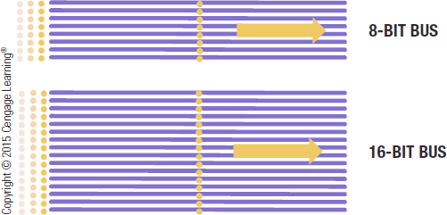
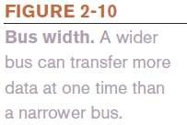
Inside the System Unit
Bus Width, Bus Speed, and Bandwidth
A bus is an electronic path over which data can travel
Found inside the CPU and on the motherboard
Bus width is the number of wires in the bus over which data can travel
A wider bus allows more data to be transferred at one time

Slide 44
How the CPU Works
CPU (Central Processing Unit)
Consists of a variety of circuitry and components packaged together
Transistor: Key element of the microprocessor
Made of semi-conductor material that acts like a switch controlling the flow of electrons inside a chip
Today’s CPUs contain hundreds of millions of transistors;
the number doubles about every 18 months (Moore’s Law)

Slide 45
How the CPU Works
Typical CPU Components
Arithmetic/Logic Unit (ALU)
Performs arithmetic involving integers and logical
operations
Floating Point Unit (FPU)
Performs decimal arithmetic
Control Unit
Coordinates and controls activities within a CPU core
Prefetch Unit
Attempts to retrieve data and instructions before they are needed for processing in order to avoid delays

Slide 46
How the CPU Works
Decode Unit
Translates instructions from the prefetch unit so they are understood by the control unit, ALU, and FPU
Registers and Internal Cache Memory
Store data and instructions needed by the CPU
Bus Interface Unit
Allows the core to communicate with other CPU components

Slide 47
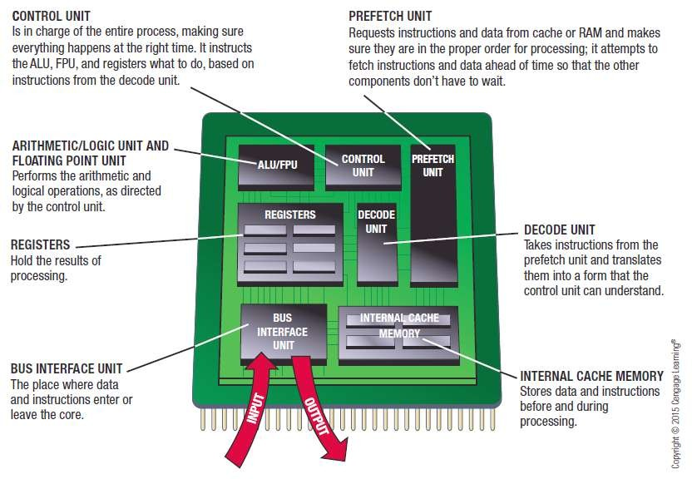

How the CPU Works

Slide 48
The System Clock and the Machine Cycle
System Clock
Small quartz crystal on the motherboard
Timing mechanism within the computer system that
synchronizes the computer’s operations
Sends out a signal on a regular basis to all computer components
Each signal is a cycle
Number of cycles per second is measured in hertz (Hz)
One megahertz = one million ticks of the system clock

Slide 49
The System Clock and the Machine Cycle
Many PC system clocks run at 200 MHz
Computers can run at a multiple or fraction of the system clock speed
A CPU clock speed of 2 GHz means the CPU clock “ticks” 10 times during each system clock tick
During each CPU clock tick, one or more pieces of microcode are processed
A CPU with a higher clock speed processes more instructions per second than the same CPU with a lower CPU clock speed

Slide 50
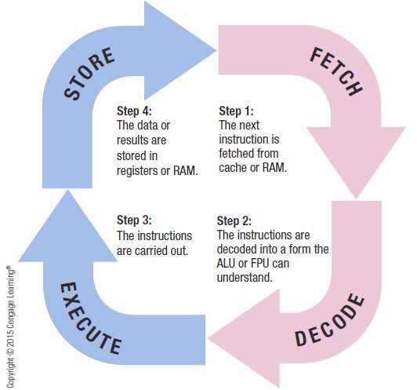
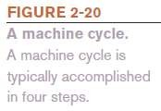
The System Clock and the Machine Cycle
Machine Cycle
– The series of operations involved in the execution of a single machine level instruction

Slide 51
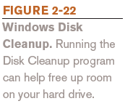
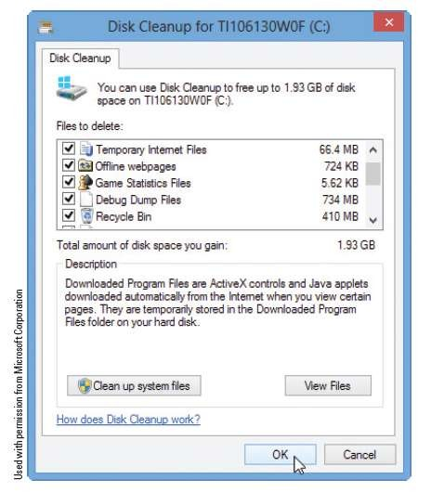
Making Computers Faster and Better Now and in the Future
Improving the Performance of Your System Today
Add more memory
Perform system maintenance
Uninstall programs properly
Remove unnecessary programs from the Startup list
Consider placing large files not needed on a regular basis on external storage
Delete temporary files

Slide 52
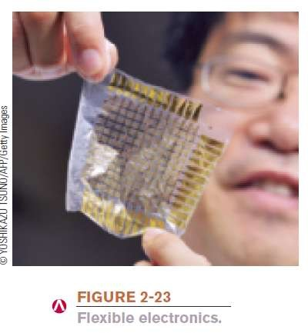
Making Computers Faster and Better Now and in the Future
Strategies for Making Faster and Better Computers
Improved Architecture
Smaller components, faster bus speeds, multiple CPU cores, support for virtualization
Improved Materials
Flexible electronic components
– Copper, high-k, graphene chip

Slide 53
Making Computers Faster and Better Now and in the Future
Pipelining
Allows multiple instructions to be processed at one time
Pipelining is a process of arrangement of hardware elements of the CPU such that its overall performance is increased
Pipelining is a technique where multiple instructions are overlapped during execution
Multiprocessing and Parallel Processing
Use multiple processors to speed up processing

Slide 54
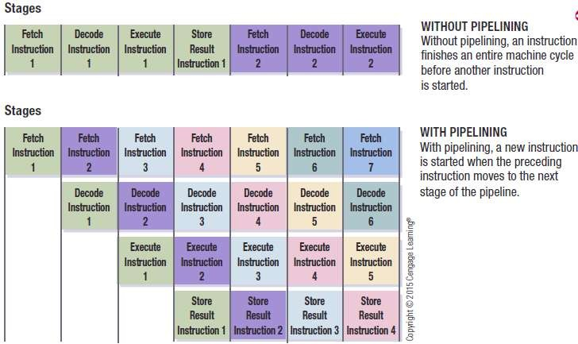
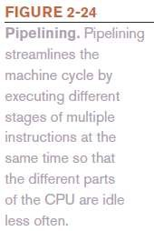
Making Computers Faster and Better Now and in the Future

Slide 55
Summary
Definition of IT
Computer Technology
Communication Technology
Role of IT in Society
Models:
Turing Model
Von Neumann Model
Input Devices
Output Devices
Central Processing Unit
Control Unit
Arithmetic & Logic Unit
System Clock & Machine Cycle

